Slide 1

Heat Pump Water Heater – Quick Simulation Approach Ben Larson and Michael Logsdon 4 November 2013
ACEEE Hot Water Forum 2013
ben@ecotope.com
4056 9th Avenue NE, Seattle, WA 98105
(206) 322-3753

Slide 2
Agenda
Motivation
HPWH Designs
Measured Data – Lab Tests
Simulation Guts – How it Runs
Simulation Results
Q&A
Notes:
The Motivation:
Can we create a fast, yet accurate simulation of HPWH performance on both a daily and annual basis suitable for integration with a whole-house energy use model?
How fast?
<0.2 seconds for a full year, <1ms for a single day (runtime on a core i7, 3.5GHz)
Avoiding CFD
The Parameters:
The simulation takes a draw schedule, water, and ambient air conditions as inputs and interacts with the house when relevant
The Questions:
Will it work?
Is it extensible or modular enough?
How do we create new simulations adapted to new equipment?
Measured Data – Lab Tests
Information needed for the simulation
Simulation Guts – How it Runs
Simulation Results
Comparison to lab tests
Moving beyond the lab
Q&A

Slide 3
HPWH Designs
Stratified Tank:
Hot water on top
Cold on bottom
Condenser coils wrapped outside of tank
Resistance Element
Condenser coils immersed in tank
Resistance Element
Notes:
There are a few general design types for HPWHs. Two are shown here.
The best designs keep water stratified so hot water is always available at the top of the tank.
The basic differences between these two designs are the heat exchanger which is either immersed in the tank or wrapped outside and how high up the tank the heat exchanger goes.
Another type of HPWH uses an external heat exchanger but that is not considered in this model.

Slide 4
Gather Lab Data
What information do we need for a simulation?
Input Power – f(T_{ambient air}, T_{tank water})
COP – f(T_{ambient air}, T_{tank water})
Control logic
Tank heat loss rate (UA)
Distribution of added heat
Notes:
We gather descriptive information about the HPWH equipment through lab tests
Input Power – f(T_{ambient air}, T_{tank water})
COP – f(T_{ambient air}, T_{tank water})
Control logic
At what temperatures do elements or compressor engage?
What is the dead band?
At what tank heights are the temperature sensors?
Tank heat loss rate (UA)
Distribution of added heat
Where in the tank are the elements and compressor?
Where does the heat appear during a recovery cycle

Slide 5
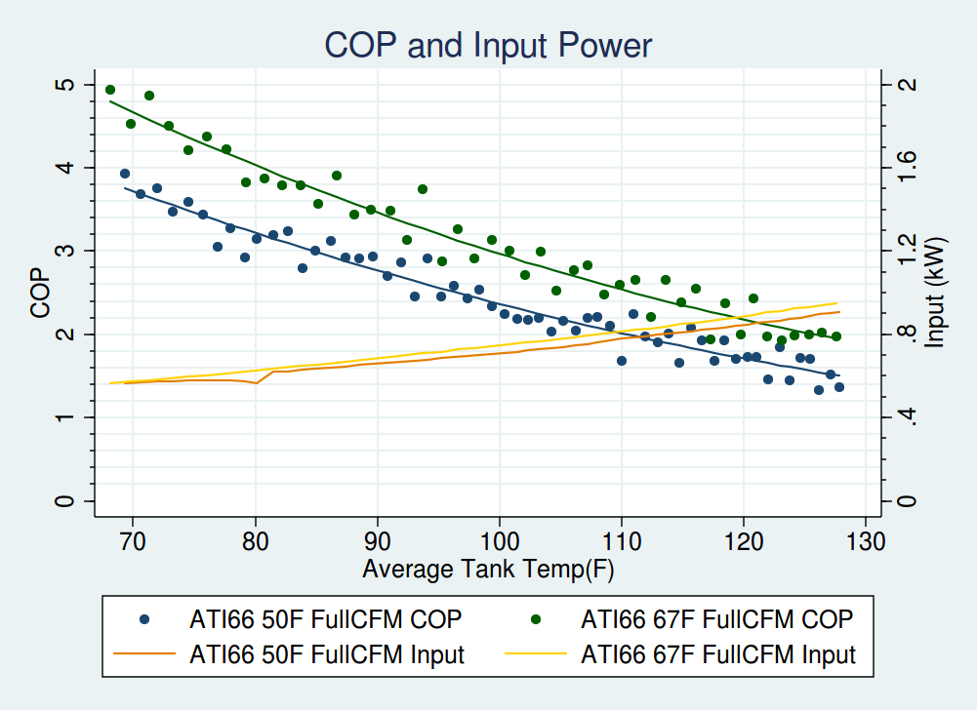
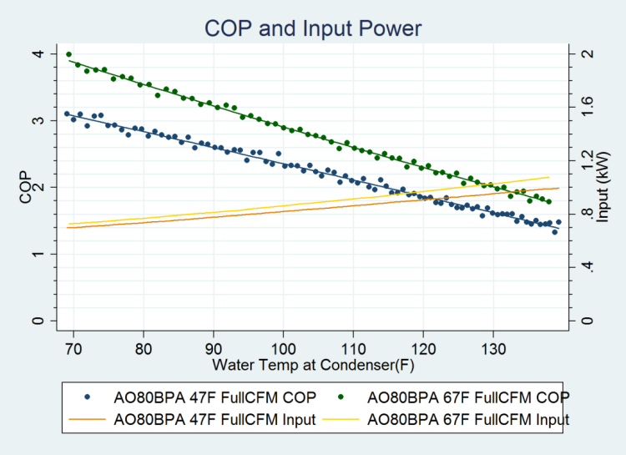
Lab Measured Performance Curves
Notes:
We start in the lab by mapping COP and input to tank temperature for two ambient air conditions: ~50°F & 67°F.
A single COP mapping test takes a day of lab time.
We fit functions to the input power and COP curves for each lab test.
Then, we scale them linearly to whatever ambient temperature we need for the water heat simulation.
Extensive testing shows linear extrapolation of COP works well for the 35°F to 85°F range
It is possible to define COP as a function of Tair, RHair, and Twater, but that proved too complicated for our purposes. There were too many functional parameters and not enough lab data to get good estimates for those parameters. Simplicity and credibility are most important here – we don’t want a complicated model that gives crazy results, we want a simple model that gives reasonable results.

Slide 6
Controls, UA, Added Heat
Control logic
product spec sheets, 24hr, 1hr, and other lab tests
Tank heat loss (UA)
observed in 24hr EF test
Adding new heat
Tank reheat/recovery periods in the 24hr & 1hr tests provide insight
Notes:
Control logic can be difficult to obtain depending on what information is published. Having more printed information speeds simulation development. Tank heat loss is easily extracted from the standby period in the stand 24hr EF test. The trickiest part of the simulation is figuring out how to add heat to the tank – specifically where.

Slide 7
Simulation Design
12-node, 1-dimensional model
1 minute time steps
Each step:
Calculate standby losses
If draw present, shift water column upward
No heat transfer calculated between nodes
Control logic activates or deactivates heating component
If heating component active, calculate COP, input power, and update temperature nodes
Lower element
Upper element
Heat pump
T12
T11
T10
T9
T8
T7
T6
T5
T4
T3
T2
T1
Notes:
It’s now worth describing the simulation design. We use a 12-node, 1-dimensional model for the tank. The simulation runs on 1-minute time-steps. Each step:
1. Reduces temperature for standby losses
2. If a draw is present, shift the water column upward
- There is no heat transfer calculated between nodes. Instead, the temperature is shifted up the nodes (tank is stratified)
3. Checks control logic and activates or deactivates heating components
4. If a heating component is active, calculate COP and input power, and update temperature nodes.
- Lower element heat appears at the highest node that is just below set point (tank is stratified)
- Upper element acts similarly except it can only heat the top 1/3 of tank.
- Heat pump provided heat through the condenser gets smeared out across nodes depending on the tank design
- The condenser temperature is set to be the bottom 1/3 or ½ of the tank depending tank design
There is no heat transfer between nodes. Each node has a mass and will absorb a certain amount of heat but can only lose heat via standby losses or by exiting the tank in a draw event. During a draw, the mass of water is shifted upwards and cold water at the inlet temperature enters the tank.

Slide 8
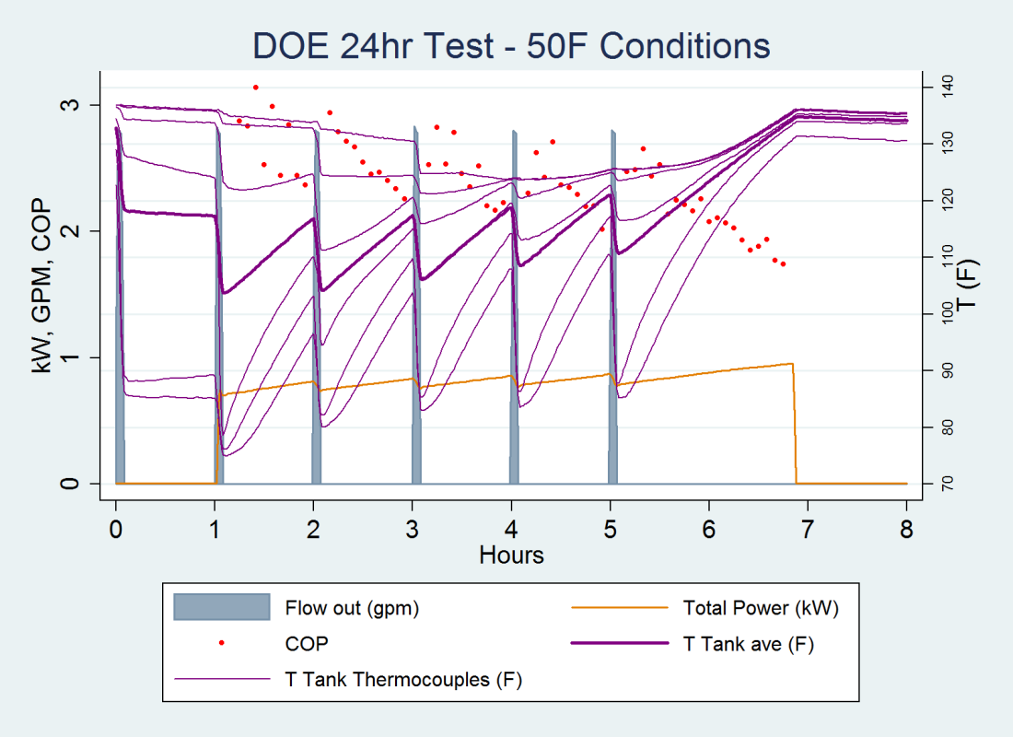
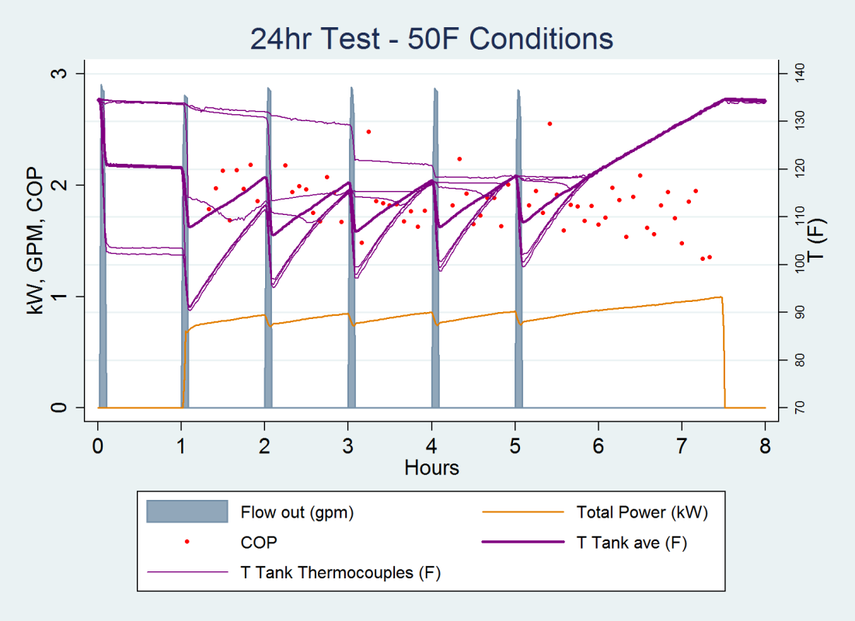
Lab Measured Reheat Cycle
← Condenser heat transferred over a larger tank height (bottom ½+)
Condenser heat transferred at the bottom
→
Notes:
The thermocouples immersed inside the tank for the test show how heat is added to the tank. Those temperatures are plotted in lavender. The left graph shows the tank adding heat over the bottom half of the tank. This appears as the concurrent increase in temperature for the bottom three thermocouples. For the graph at right, the heat is added almost entirely at the bottom of the tank. The heating occurs from the bottom up as opposed to the bottom and sides.

Slide 9
Distributing Added Heat
Different condensers “see” different temperature profiles
Different designs add heat to the tank differently
Condenser height
Notes:
There are two things going on. First, different condensers see different temperature profiles leading to different heat transfer efficiencies.
A perfect simulation would integrate over heat exchanger area and stratified temperature to compute a temperature “seen” by the condenser. This is computationally intensive and the stochasticity of water mixing means it might not produce a better result. Further, in the lab tests for COP mapping, we are only able to get the relationship between a uniform tank temperature and COP. Real world draws create the situation of having a varying temperature over the condenser. Only a large and complicated lab testing suite could map that relationship. Therefore our approach is to calculate a water temperature over the bottom ½ or 1/3 of tank depending on design.
Second, when the condenser is hot, some tanks get heated higher up than others so the appears at different heights at different times. We’d like to know at which nodes the heat appears for given heating regime. Our approach is to use manually tuned equations to distribute heat in such a way as to match simulation patterns to measured patterns.

Slide 10

Adding Heat to Nodes
Each time step, each node gets a fraction of the heat added:
c(n) - the fraction of total heat added going in to node n, where n=1-12
T_{n} - temperature of a node (°F)
T₁ - bottom node temperature (°F)
T_{set} - tank setpoint (°F)
ofst - 5
Tunable parameters (vary based on HPWH equipment):
s - “shrinkage” – perceived distance between lower and upper tank
p - shape – modifies concavity with which Tn approach setpoint
note: output of c(n) needs to be normalized so fractions sum to 1 across all nodes
$$c\left(n\right)=\frac{1}{1+e^{\left(\frac{T_{n}−T_{1}}{s}−ofst\right)}}×{\left(T_{set}−T_{n}\right)}^{p}$$
Notes:
The distribution of heat added is the product of two functions describing the geometry of where the heat should go.
The first part is a logistic function which contains the shrinkage parameter. A large value for s brings the top and bottom parts of the tank closer together so that heat is added at all tank heights more evenly. A small value for s adds heat only to the bottom nodes first.
The second part is a power-law relationship which describes how the tank node temperatures approach the setpoint. It is loosely related to the mixing in the tank. A more stratified tank will have a larger exponent, p. Although, tanks that heat higher nodes with a taller condenser will also tend to have a larger value.

Slide 11
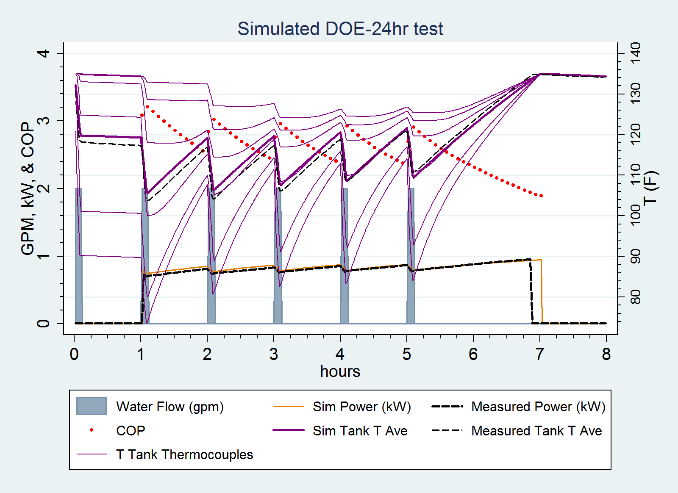
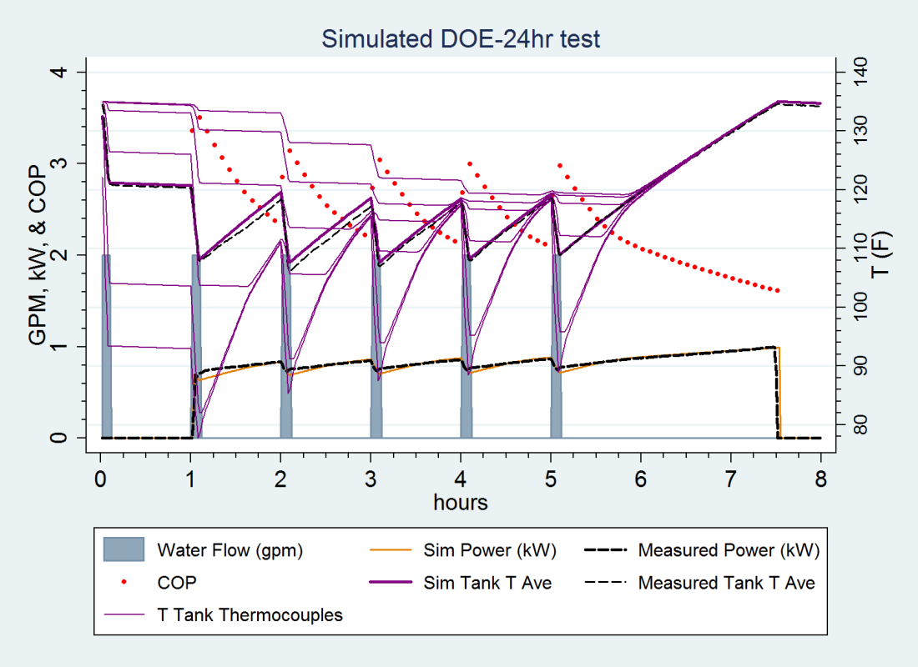
Does it work?
Voltex 60 on top.
s = 3.7, p = 1.0
ATI66 at right.
s = 0.4, p = 1.4
Notes:
Putting it all together. We use the input power and COP maps, heat loss rate, control strategy, and description of where to add heat to simulate the 24hr EF tests.
Black dashes are the values measured in the lab tests. All other data is simulated.
The simulations show good results.

Slide 12
Sure, but how well?
Compare simulation to lab tests:
EF67 is 24hr test under standard conditions
EF50 is 24hr test with 50°F air and inlet water from the Northern Climate Test Spec
Conclusion:
Reasonable match to data
Unit | Test | Measured Results | Simulated Results
Voltex 60 | EF50 | 2.19 | 2.16
 | EF67 | 2.36 | 2.35
ATI 66 | EF50 | 1.94 | 2.01
 | EF67 | 2.18 | 2.21

Slide 13
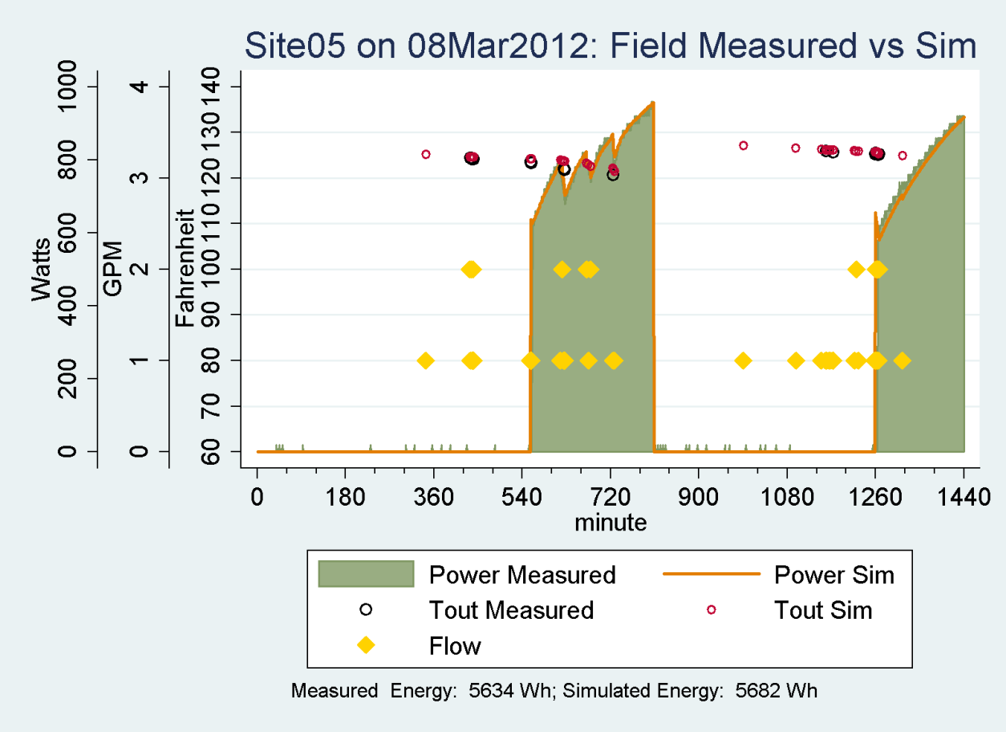
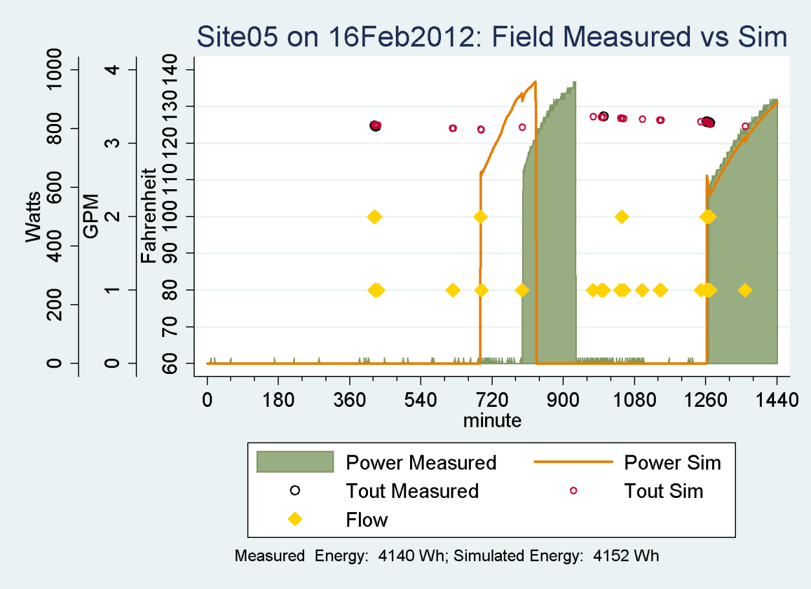
Field Data Comparison
Notes:
Matching EF tests is well and good, but what about real houses? How does the simulation do there? This slide shows two graphs which compare the measured HPWH energy use in houses to the simulation. The measurements come from real houses. Then, we fed those draw patterns, ambient air, and inlet water temperatures to the simulation. It produced the orange lines in the graphs. Top right shows an excellent match to the compressor only operation. Bottom left shows a poor match – the energy use is about right but the timing is off.

Slide 14
Recap
Geometric description approach works
Simulation framework is extensible
Lab tests needed:
COP mapping of HPWH at 50°F and 67.5°F
24hr EF and 1hr rating tests
Promising initial comparison to field measurements
More work and comparisons coming in 2014
Notes:
The geometric description modeling approach works because the water is temperature stratified and heat exchange predictable
The simulation framework is extensible. To model a new HPWH, one needs:
- The lab tests to determine the input power and COP different ambient conditions
- COP mapping of HPWH at 50°F and 67.5°F
- 24hr EF and 1hr rating tests
- The EF and 1hr rating tests provide a good dataset
from which to determine the tunable shape and shrinkage parameters
Initial comparison to field measurements is promising. More work and comparisons coming in 2014

Slide 15
Thank You
Ben Larson
Ecotope, Inc
Seattle, WA
206.322.3753
ben@ecotope.com

Slide 16
